Slide 1
Shortest Paths in a Directed Acyclic Graph
Instructor: Kshitij Gajjar
Centre for Security, Theory and Algorithmic Research (CSTAR)
International Institute of Information Technology, Hyderabad

Slide 2
Shortest Paths in Directed Acyclic Graphs
A
$$7$$
A | B | C | D | E | F
$$4$$
C
$$−5$$
B
$$3$$
$$5$$
$$6$$
E
$$4$$
$$−2$$
$$4$$
D
$$5$$
F

Slide 3

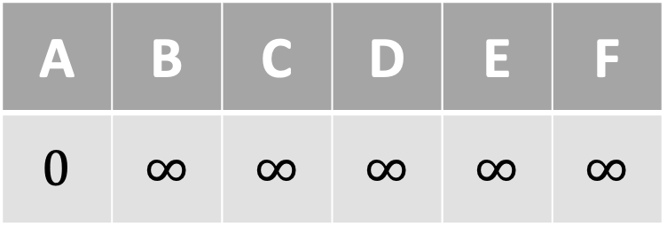









Shortest Paths in Directed Acyclic Graphs
A
$$7$$
A | B | C | D | E | F
$$0$$ | $$∞$$ | $$∞$$ | $$∞$$ | $$∞$$ | $$∞$$
$$4$$
C
$$−5$$
B
$$3$$
$$5$$
$$6$$
E
$$4$$
$$−2$$
$$4$$
D
$$5$$
F

Slide 4






Shortest Paths in Directed Acyclic Graphs
$$0$$
$$7$$
A | B | C | D | E | F
$$0$$ | $$∞$$ | $$∞$$ | $$∞$$ | $$∞$$ | $$∞$$
$$4$$
$$∞$$
$$−5$$
$$∞$$
$$3$$
$$5$$
$$6$$
$$∞$$
$$4$$
$$−2$$
$$4$$
$$∞$$
$$5$$
$$∞$$

Slide 5
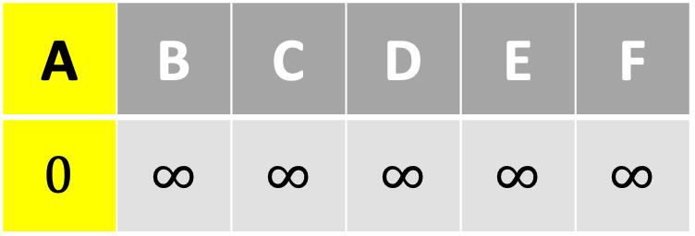
Shortest Paths in Directed Acyclic Graphs
$$0$$
$$7$$
A | B | C | D | E | F
$$0$$ | $$∞$$ | $$∞$$ | $$∞$$ | $$∞$$ | $$∞$$
$$4$$
$$∞$$
$$−5$$
$$∞$$
$$3$$
$$5$$
$$6$$
$$∞$$
$$4$$
$$−2$$
$$4$$
$$∞$$
$$5$$
$$∞$$

Slide 6

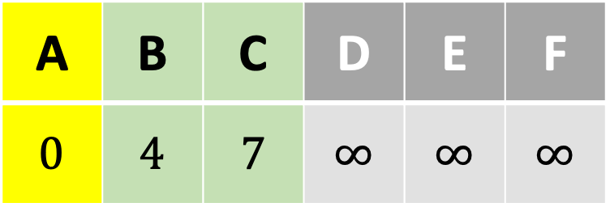

Shortest Paths in Directed Acyclic Graphs
$$0$$
$$7$$
A | B | C | D | E | F
$$0$$ | $$4$$ | $$7$$ | $$∞$$ | $$∞$$ | $$∞$$
$$4$$
$$∞$$
$$−5$$
$$∞$$
$$3$$
$$5$$
$$6$$
$$∞$$
$$4$$
$$−2$$
$$4$$
$$∞$$
$$5$$
$$∞$$

Slide 7
A Puzzle
Q: What fact about directed acyclic graphs does this algorithm use?
A: Every directed acyclic graph contains at least one source (that is, a vertex which has no incoming edges).

Slide 8
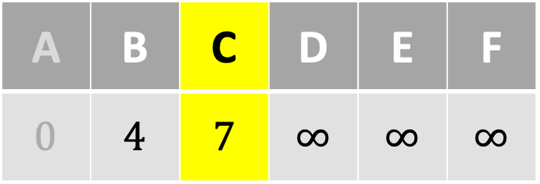
Shortest Paths in Directed Acyclic Graphs
$$0$$
$$7$$
A | B | C | D | E | F
$$0$$ | $$4$$ | $$7$$ | $$∞$$ | $$∞$$ | $$∞$$
$$4$$
$$7$$
$$−5$$
$$4$$
$$3$$
$$5$$
$$6$$
$$∞$$
$$4$$
$$−2$$
$$4$$
$$∞$$
$$5$$
$$∞$$

Slide 9


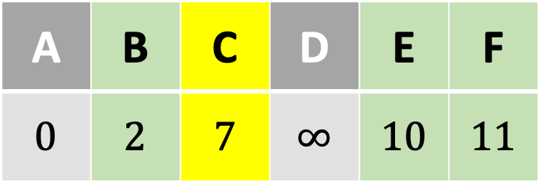

Shortest Paths in Directed Acyclic Graphs
$$0$$
$$7$$
A | B | C | D | E | F
$$0$$ | $$2$$ | $$7$$ | $$∞$$ | $$10$$ | $$11$$
$$4$$
$$7$$
$$−5$$
$$4$$
$$3$$
$$5$$
$$6$$
$$∞$$
$$4$$
$$−2$$
$$4$$
$$∞$$
$$5$$
$$∞$$

Slide 10
Shortest Paths in Directed Acyclic Graphs
$$0$$
$$7$$
A | B | C | D | E | F
$$0$$ | $$2$$ | $$7$$ | $$∞$$ | $$10$$ | $$11$$
$$4$$
$$7$$
$$−5$$
$$2$$
$$3$$
$$5$$
$$6$$
$$10$$
$$4$$
$$−2$$
$$4$$
$$∞$$
$$5$$
$$11$$

Slide 11


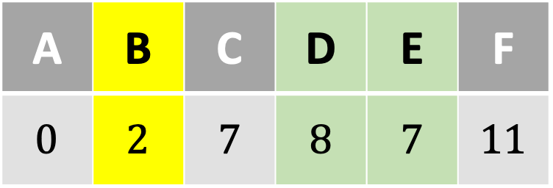
Shortest Paths in Directed Acyclic Graphs
$$0$$
$$7$$
A | B | C | D | E | F
$$0$$ | $$2$$ | $$7$$ | $$8$$ | $$7$$ | $$11$$
$$4$$
$$7$$
$$−5$$
$$2$$
$$3$$
$$5$$
$$6$$
$$10$$
$$4$$
$$−2$$
$$4$$
$$∞$$
$$5$$
$$11$$

Slide 12
Shortest Paths in Directed Acyclic Graphs
$$0$$
$$7$$
A | B | C | D | E | F
$$0$$ | $$2$$ | $$7$$ | $$8$$ | $$7$$ | $$11$$
$$4$$
$$7$$
$$−5$$
$$2$$
$$3$$
$$5$$
$$6$$
$$7$$
$$4$$
$$−2$$
$$4$$
$$8$$
$$5$$
$$11$$

Slide 13


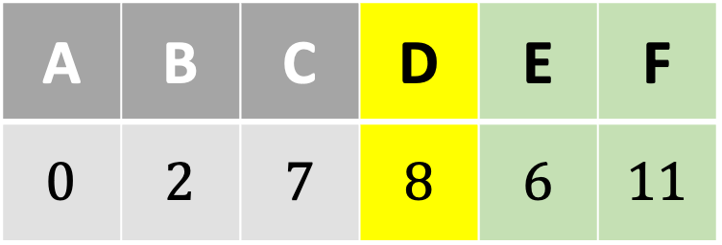
Shortest Paths in Directed Acyclic Graphs
$$0$$
$$7$$
A | B | C | D | E | F
$$0$$ | $$2$$ | $$7$$ | $$8$$ | $$6$$ | $$11$$
$$4$$
$$7$$
$$−5$$
$$2$$
$$3$$
$$5$$
$$6$$
$$7$$
$$4$$
$$−2$$
$$4$$
$$8$$
$$5$$
$$11$$

Slide 14
Shortest Paths in Directed Acyclic Graphs
$$0$$
$$7$$
A | B | C | D | E | F
$$0$$ | $$2$$ | $$7$$ | $$8$$ | $$6$$ | $$11$$
$$4$$
$$7$$
$$−5$$
$$2$$
$$3$$
$$5$$
$$6$$
$$6$$
$$4$$
$$−2$$
$$4$$
$$8$$
$$5$$
$$11$$

Slide 15
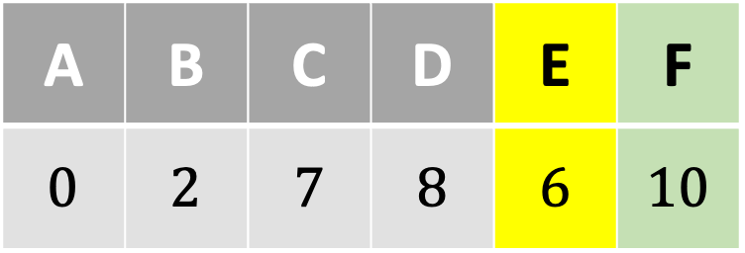
Shortest Paths in Directed Acyclic Graphs
$$0$$
$$7$$
A | B | C | D | E | F
$$0$$ | $$2$$ | $$7$$ | $$8$$ | $$6$$ | $$10$$
$$4$$
$$7$$
$$−5$$
$$2$$
$$3$$
$$5$$
$$6$$
$$6$$
$$4$$
$$−2$$
$$4$$
$$8$$
$$5$$
$$11$$

Slide 16
Shortest Paths in Directed Acyclic Graphs
$$0$$
$$7$$
A | B | C | D | E | F
$$0$$ | $$2$$ | $$7$$ | $$8$$ | $$6$$ | $$10$$
$$4$$
$$7$$
$$−5$$
$$2$$
$$3$$
$$5$$
$$6$$
$$6$$
$$4$$
$$−2$$
$$4$$
$$8$$
$$5$$
$$10$$

Slide 17
Shortest Paths in Directed Acyclic Graphs
$$s=$$
$$0$$
$$7$$
A | B | C | D | E | F
$$0$$ | $$2$$ | $$7$$ | $$8$$ | $$6$$ | $$10$$
$$4$$
$$7$$
$$−5$$
$$2$$
$$3$$
$$5$$
$$6$$
$$6$$
$$4$$
$$−2$$
$$4$$
$$8$$
$$5$$
$$10$$
$$=t$$

Slide 18
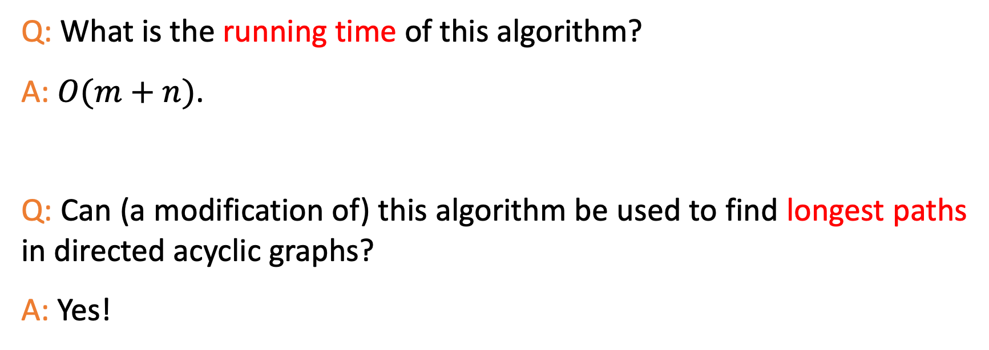
Another Puzzle
Q: What is the running time of this algorithm?
A: $O(m+n)$.
Q: Can (a modification of) this algorithm be used to find longest paths in directed acyclic graphs?
A: Yes!

Slide 19

Thank You!

